Slide 1
Python PROGRAMMING LANGUAGE

Slide 2
Introduction to Python
Definition of Python : Python is a high-level, interpreted programming language created in 1991, known for its readable syntax and cross-platform support.
Common Applications : Python is widely used in web development, data science, automation, software testing, game development, and scientific computing.
Reasons to Learn Python : Python is easy to learn, supports multiple programming paradigms, has extensive libraries, and is highly valued in the job market.

Slide 3
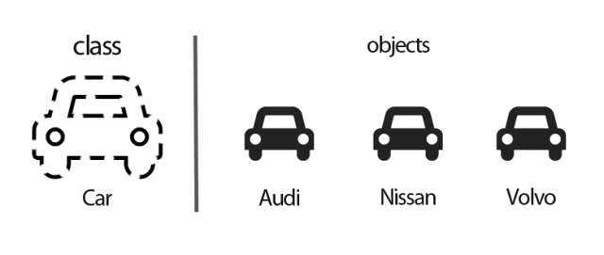
Classes and Objects in Python
Class:- A class serves as a blueprint or a template for creating objects.
Objects:-An object is a fundamental concept representing an instance of a class.

Slide 4
Variables in Python
Variable Declaration in Python | Rules for Naming Variables | Example of Variable Initialization
Variables are declared by assigning values using '=' without explicit type declaration, as Python infers the type automatically. | Variable names must start with a letter or underscore, are case-sensitive, cannot start with numbers. | Variables like age = 25, name = 'Alice', and is_student = True demonstrate integer, string, and boolean types respectively.

Slide 5
Data Types in Python
Integer Data Type Represents whole numbers without decimals, such as 45 or -90. Immutable in nature. | Floating-Point Data Type Used for decimal numbers like 17.23 or -0.99. Also immutable. | String Data Type Represents sequences of characters enclosed in quotes, e.g., "Hello". Immutable.

Slide 6
Operators in Python
Arithmetic Operators Python arithmetic operators perform basic math operations like addition, subtraction, multiplication, division, modulus, exponentiation, and floor division. | Comparison Operators Comparison operators evaluate relationships between values, returning Boolean results such as equal to, not equal to, greater than, and less than. | Logical Operators Logical operators combine Boolean expressions using and, or, and not to control logical flow in Python programs.

Slide 7
Lists in Python
Definition of Lists in Python Lists are versatile, mutable data structures that store ordered collections of items of various data types.
Creating and Accessing Lists Lists are created using square brackets with comma-separated values and accessed via zero-based indexing.
Common List Methods Methods like append() add items to the end, while remove() deletes the first occurrence of a specified item.

Slide 8
Tuples in Python
Definition of Tuples Tuples are immutable sequence data types in Python, defined by parentheses and separated by commas. | Key Difference from Lists Unlike lists, tuples cannot be modified after creation, ensuring data remains constant.

Slide 9


Create a Function
A function is a block of code that performs a specific task.
def greet():
print('Hello World!')
Printing hello world without using function:-
Addition of two numbers:-

Slide 10
THANK YOU

